Slide 1
inventory analytics
Project Report
on

Slide 2
Project Name : Inventory Analytics
Mentor: SURAJ KUMAR
Group No- 06 Mr. Alan Ms. Srija
Ms. Arpita
Mr. Areef Nazeerrahmed Alawandi
Mr. Manthesh B.C
Mr. Sagar
Mr.Ankush

Slide 3
Agenda
Introduction & Problem Statement
Business Objectives
KPI’s Overview
Dashboard
Conclusion

Slide 4
Introduction
Inventory analytics involves the collection and analysis of inventory-related data, including product data, performance metrics, stocks data, product sales, state wise sales and other relevant data points. By using advanced analytical tools and techniques, analytics provides valuable insights into inventory processes and trends, enabling organizations to make more informed decisions about their products and improve overall performance.
Problem Statement:
Total Sales(MTD,QTD,YTD)
Product Wise Sales
Sales Growth
Monthly Sales Trend
State Wise Sales
Top 5 Store Wise Sales
Region Wise Sales
Total Inventory
Inventory Value
Over stock, Out Stock , Under stock

Slide 5
Business Objective
An inventory analytics project typically aims to improve the management and optimization of a company's inventory by leveraging data analysis and insights. The specific objectives of such a project may vary based on the organization's needs and industry, but here are some common objectives for an inventory analytics project: Optimize Stock Levels, Cost Reduction, Inventory Turnover Improvement, Data Visibility and Integration, Risk Management, Performance Metrics

Slide 6
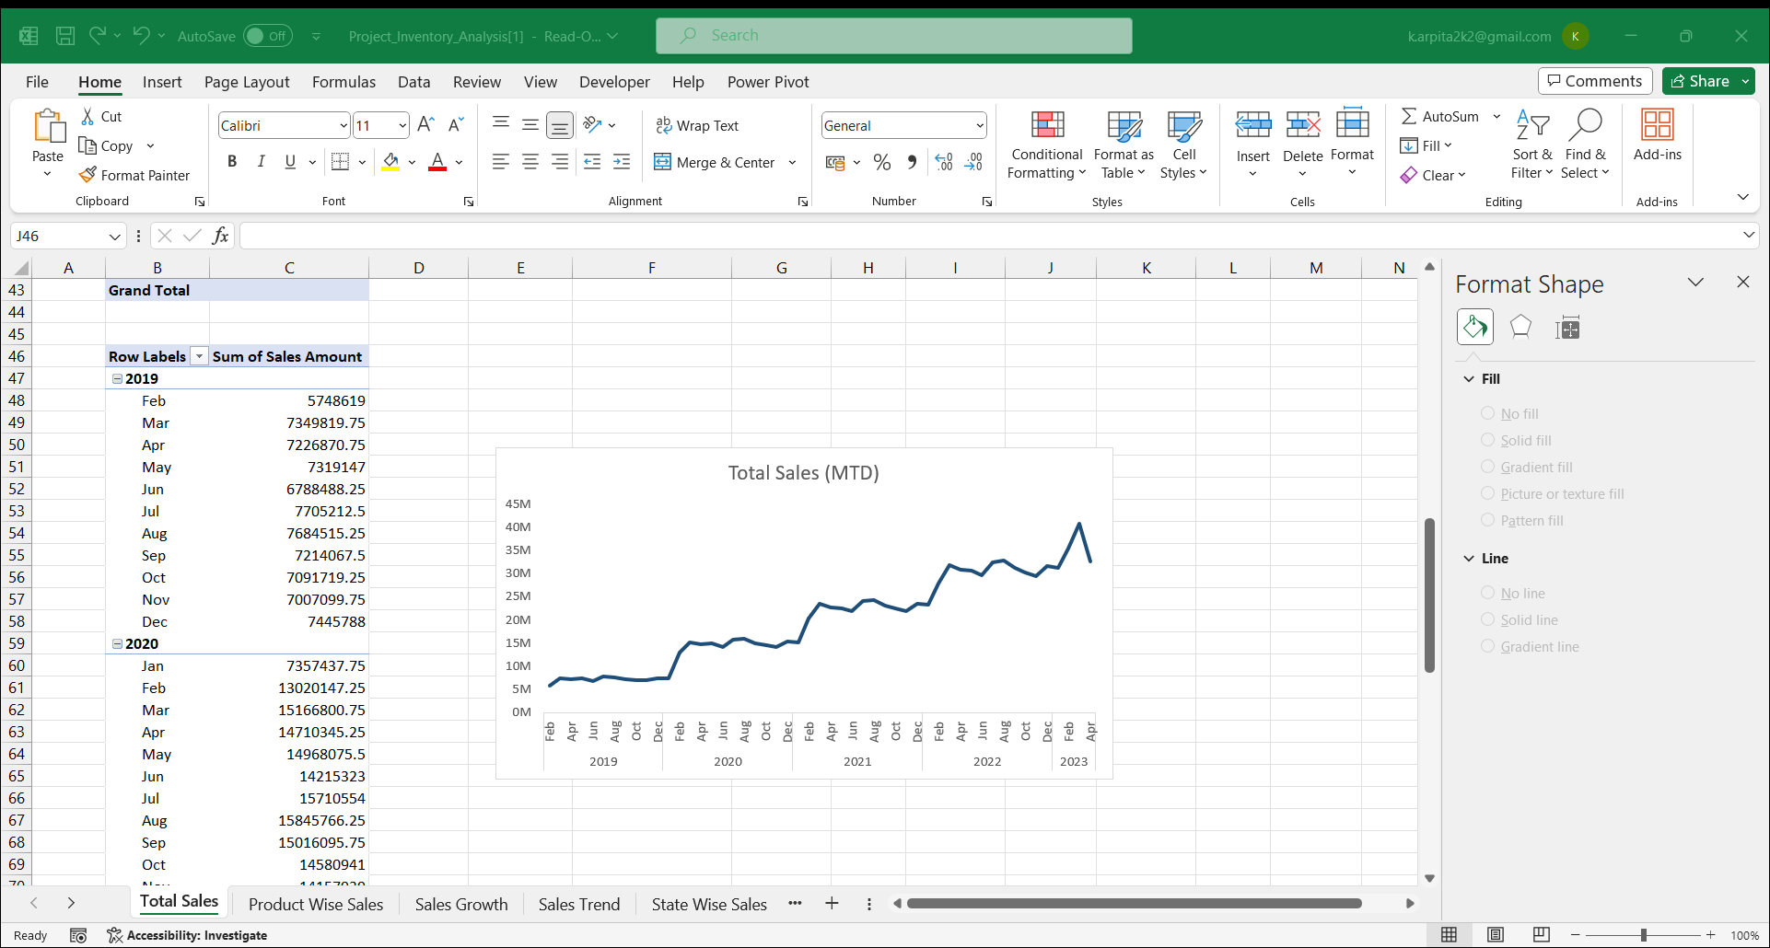
Total Sales
From this analysis we can see the Total Sales with respect to Month-to-Date(MTD).
The graphs depicts the monthly sales with respect to MTD.
We can always see a jump in sales, in the 1st Quarter.

Slide 7
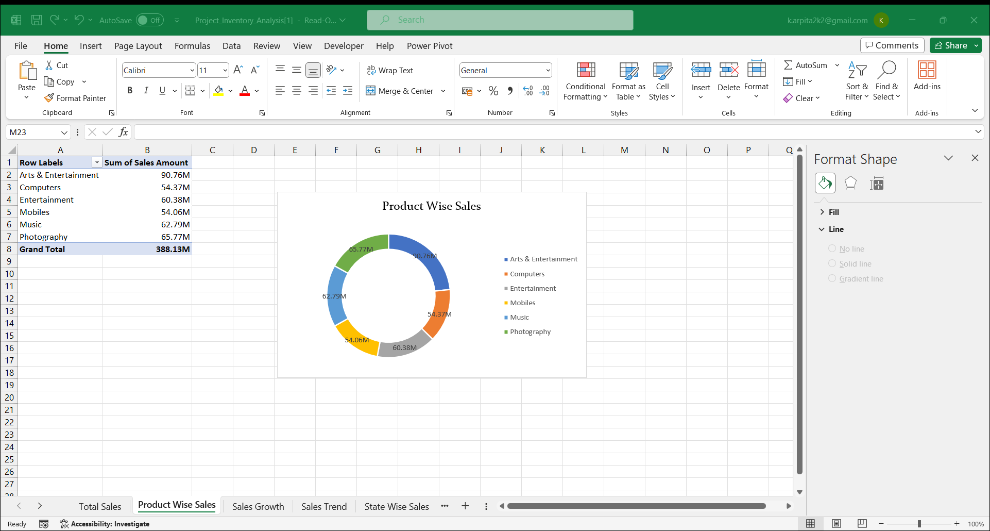
Product wise Sales
From this analysis we can see that the Product wise Sales.
Arts & Entertainment - Highest Product Sale (90.76M):
This category stands out as the top performer in terms of product sales, generating a substantial revenue of $90.76 million. Understanding the factors contributing to the success of Arts & Entertainment products can be crucial for replicating strategies or leveraging the popularity of this category for future growth.
Mobiles - Lowest Product Sale (54.06M):
Mobiles emerge as the category with the lowest product sales, amounting to $54.06 million. This insight indicates potential challenges or areas where improvements may be needed. It could prompt a closer examination of market trends, consumer preferences, or competitive factors affecting the performance of mobile products.

Slide 8
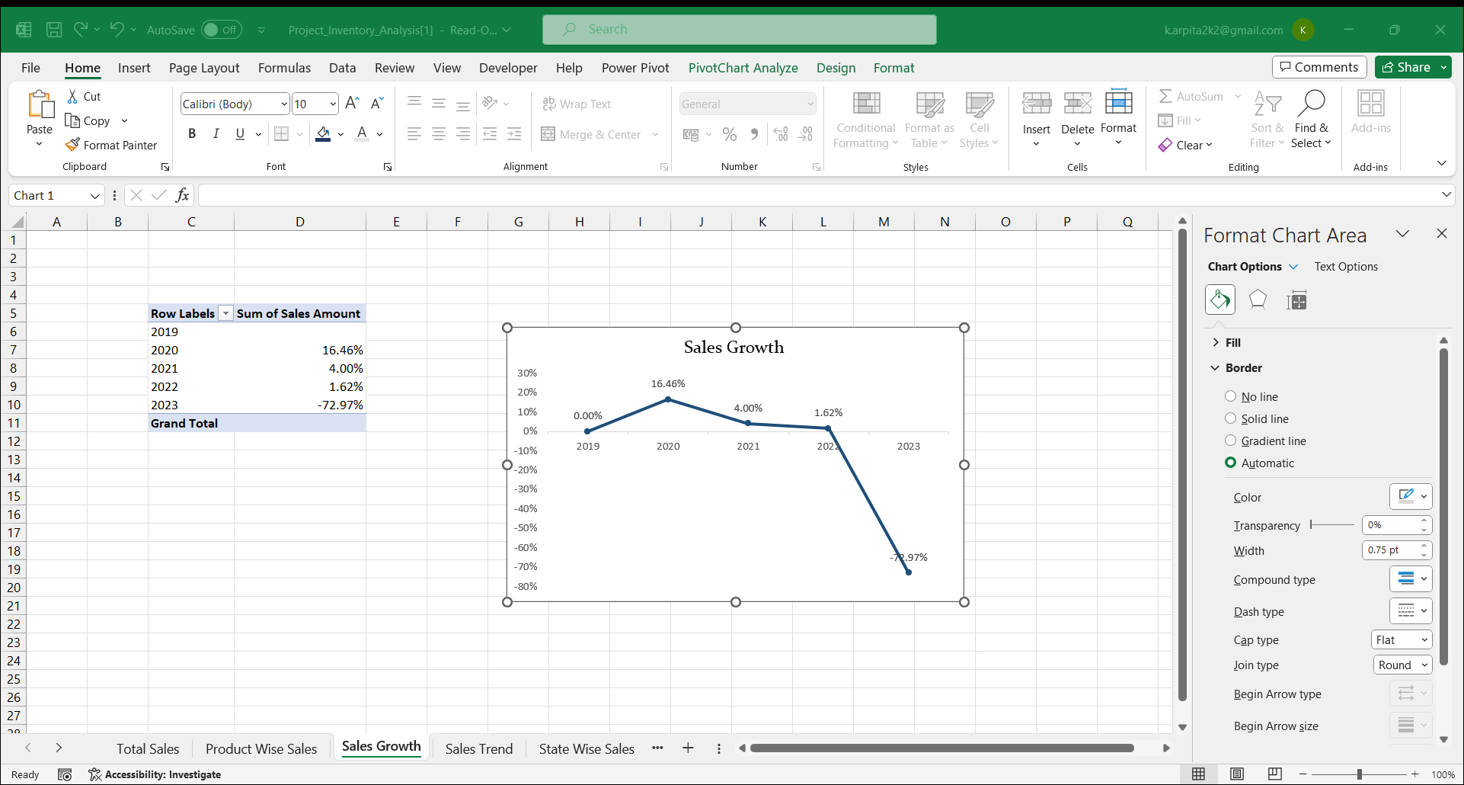
Sales Growth
From this analysis we can see that the Sales Growth by year
In the year of 2020 the sales growth is high with 16.46%.
In the year of 2023 the sales growth is low with -72.97%.

Slide 9
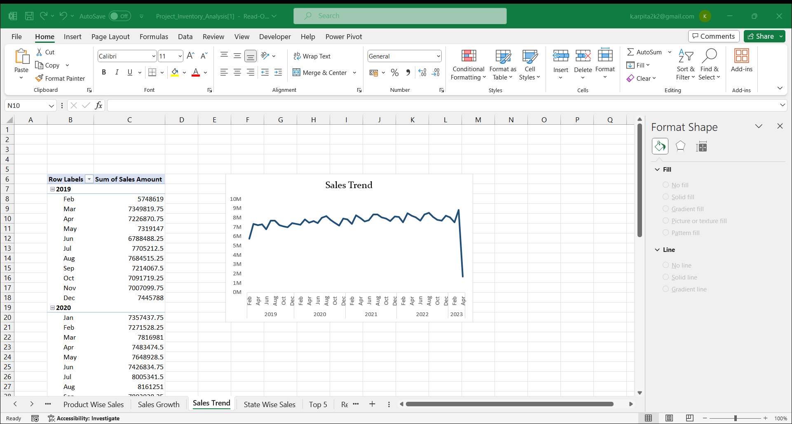
Sales Trend
From this analysis we can see Sales Trend through time starting from January 2019 up until April 2023.
We can clearly see a decrease in the sales mid-year right after the 2nd Quarter, every year.
We can observe a drastic fall in the sales by April 2023

Slide 10
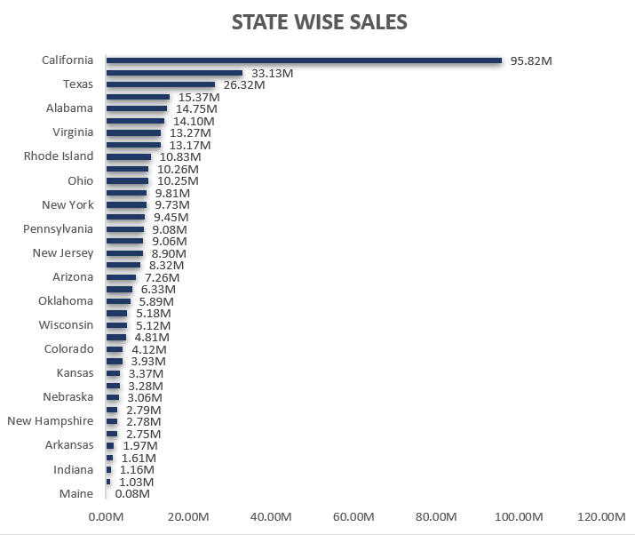
State Wise Sales
From this analysis we can see the State Wise Sales.
Highest Sales in California State (95.82M):
California emerges as the leading state in terms of sales, generating a substantial revenue of $95.82 million. This could be indicative of a large customer base, a robust market presence, or successful marketing strategies in the California region. Understanding the factors contributing to the high sales in California can be crucial for sustaining and replicating this success in other markets.
Lowest Sales in Maine State (0.08M):
Maine State registers the lowest sales, amounting to $0.08 million. This suggests a relatively smaller market presence or potential challenges in that particular region. Exploring the reasons behind the low sales in Maine, such as demographic factors, market saturation, or specific product preferences, can inform decisions on whether to invest further in that market or adjust strategies accordingly.

Slide 11
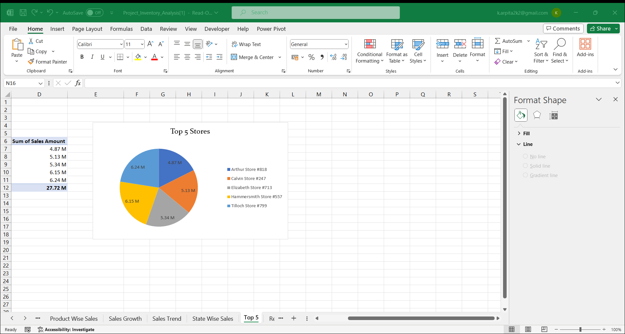
Top 5 Store Wise Sales
From this analysis we can see Top 5 Stores with the Sales Amount.
The Top store is Tilloch Store with 6.24M.
The Lowest Store is Arthur Store with 4.87M.
The other stores like Calin Store has 5.13M, Elizabeth Store has 5.34M and Hammersmith store has 6.15M.

Slide 12
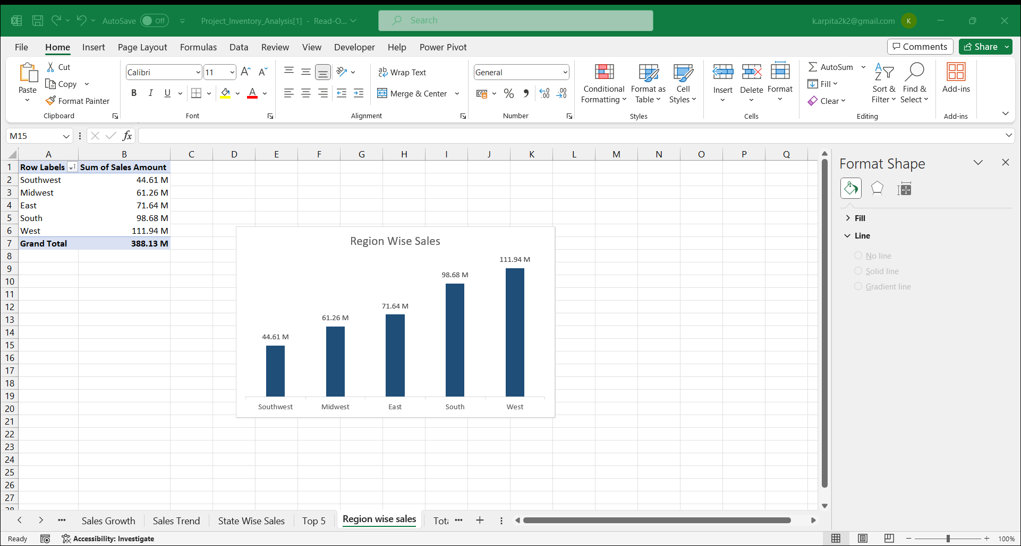
Region Wise Sales
From this analysis we can see the Sales by Region.
The West region has 29% sales with the highest amount of 111.94M.
The Southwest region has 12% sales with the lowest amount of 44.61M.

Slide 13
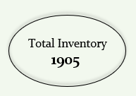

Total Inventory
From this analysis we can see the Total Inventory Value.
Total Inventory Value:
The analysis provides insight into the overall value of the entire inventory.
While the specific monetary value is not mentioned, the mention of the "Total Inventory Value" suggests that it represents the combined worth of all items or products within the inventory.
Inventory Value:
The Total inventory value is specified as 1906 and inventory value is 0.7M
Inventory Value

Slide 14
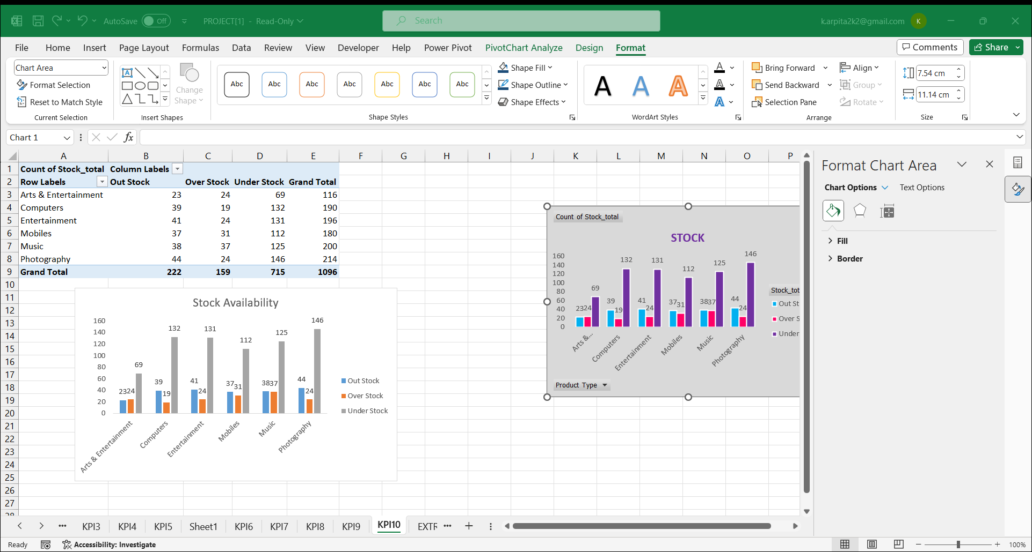
Over stock, Out Stock , Under stock
From this analysis we can see Stocks that has Out stock, Over stock and Under stock.
Through this analysis we can see that the stock is well maintained.
Over stock is high in every product type.

Slide 15
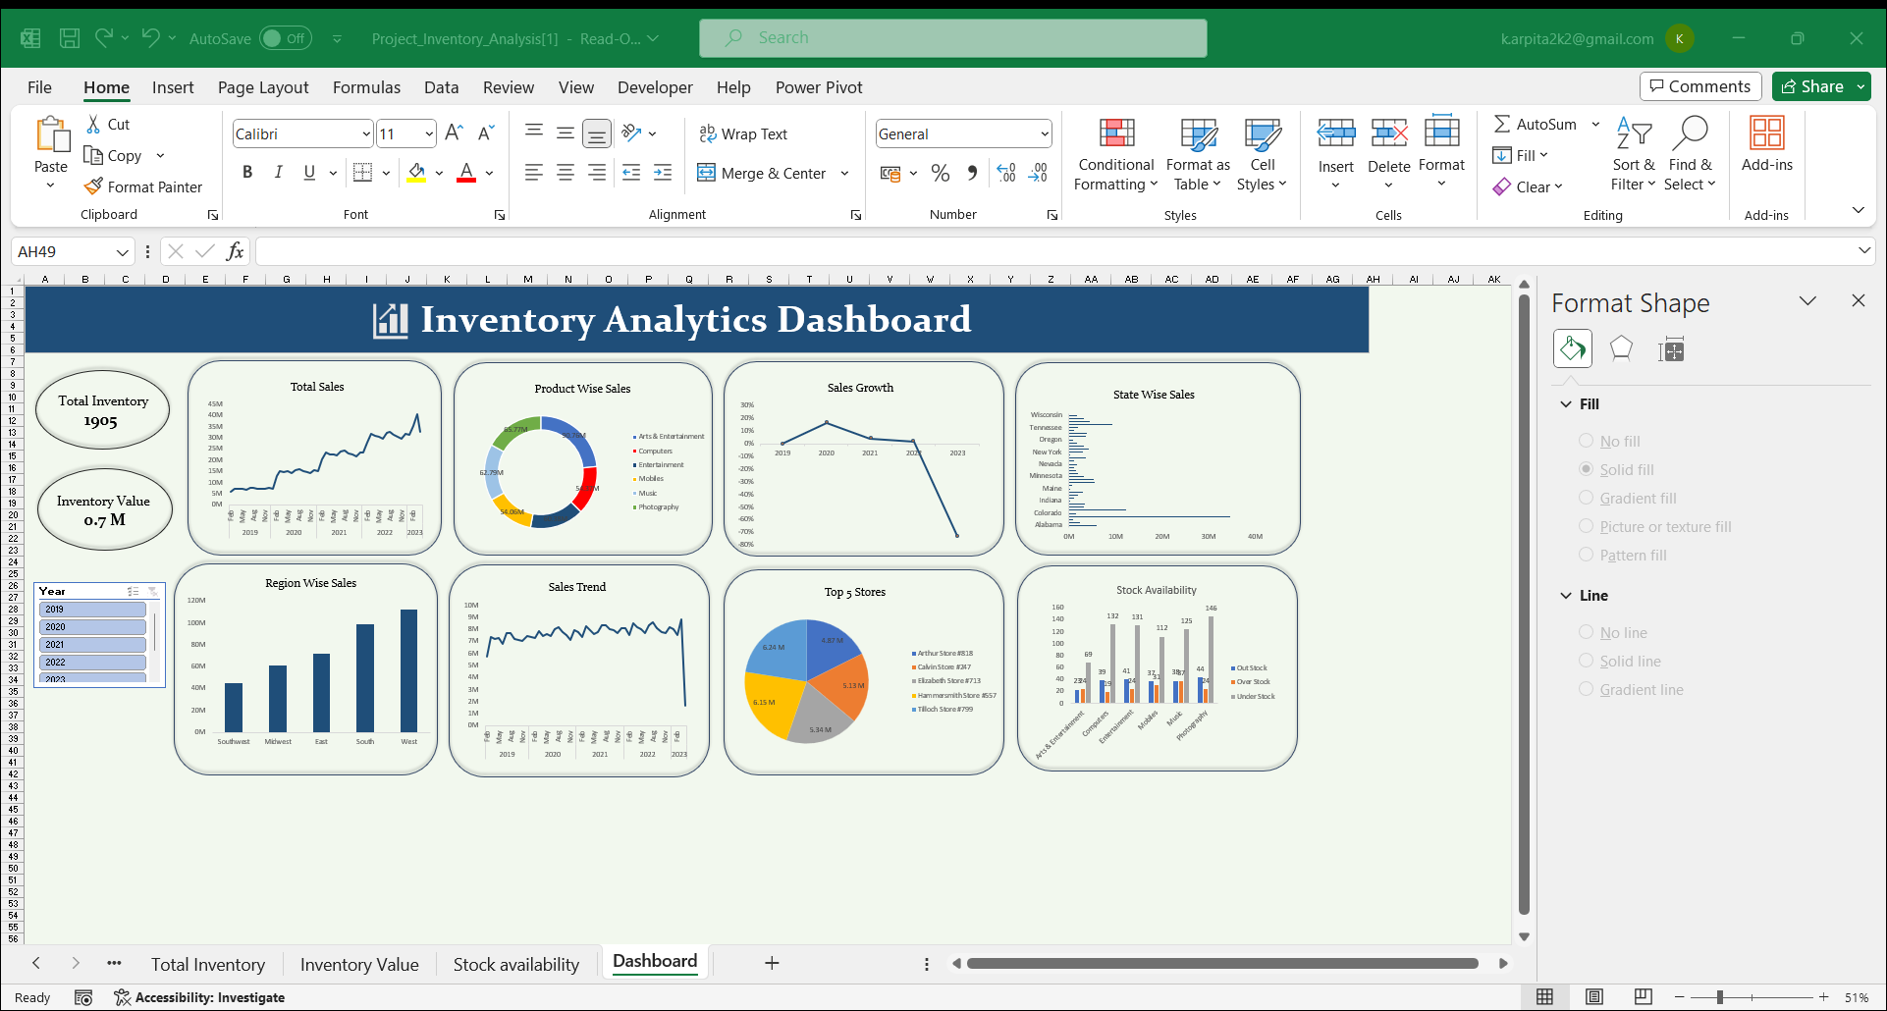

Slide 16
Conclusion
inventory management is a critical process for any business to help ensure that it has the right amount of inventory at the right time. It involves forecasting, ordering, receiving, storing, and tracking inventory levels and can have a major impact on the success or failure of a business. By integrating effective inventory processes and techniques, businesses can stay on top of their stock levels and order the right amount of inventory to meet customer demands.

Slide 17
Thank You

